Slide 1
SoundRave
(Practical Project)
Cohort: 22AprEnable1
Group: Team 2

Slide 2
Introduction
Fundamentals:
Minimum Viable Product (MVP):
Project scope:

Slide 3
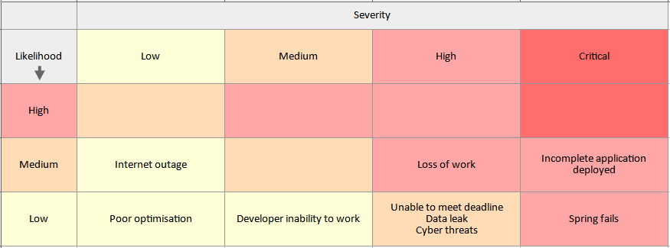
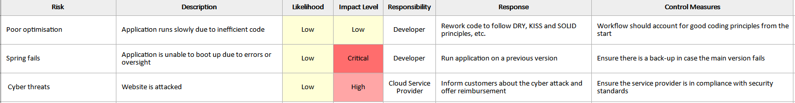
Risk Assessment
Work from home still can carry risk in regards to software development.
The matrix to the right is an example of the different risks that could occur.

Slide 4
MoSCoW Prioritisation

Slide 5
Jira – Anatomy of a Sprint

Slide 6
Entity Relationship Diagrams

Slide 7
UML Class Diagrams
This UML class diagram indicates how the classes interact with each other.

Slide 8
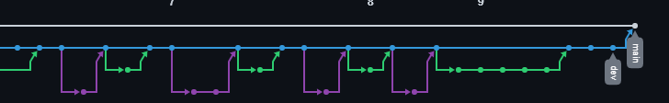
GitHub
Commits and changes were made to GitHub following the feature branch model.
Initially, a ‘dev’ branch was made, and then ‘feature’ branches off of the ‘dev’ branch to accommodate separate epics, such as Frontend, Backend and Testing.

Slide 9
Testing - Unit Tests

Slide 10
Testing - Selenium
Selenium testing was used to check how the frontend holds up with requests.

Slide 11
Live Demo

Slide 12
Conclusion - Sprint Review

Slide 13
Conclusion - Developer Journey

Slide 14
Thanks for your time!
If there are any questions, feel free to ask away.

